Slide 1
Software Architecture Report
Team LER: APH O&M Alexa Skill
Eric Schulze, Ryan Gosling, Larome Dickerson

Slide 2
Overview
Alexa O&M Trivia Skill
Used by APH to teach orientation and mobility to the blind and visually impaired

Slide 3
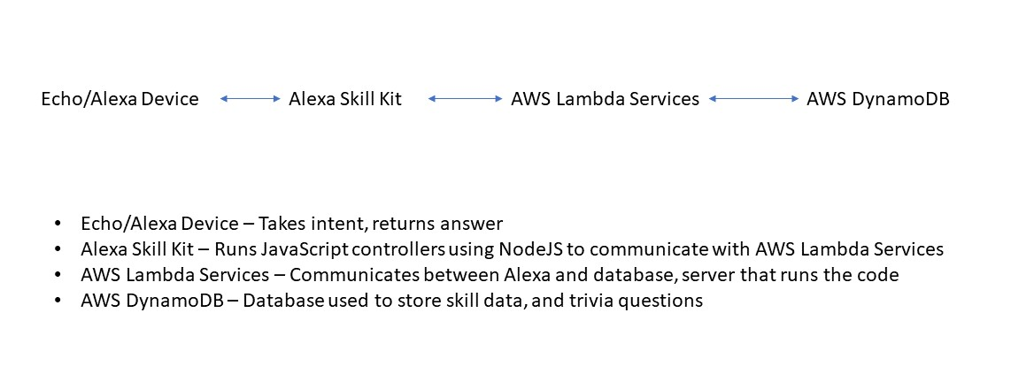
Subsystem Decomposition

Slide 4
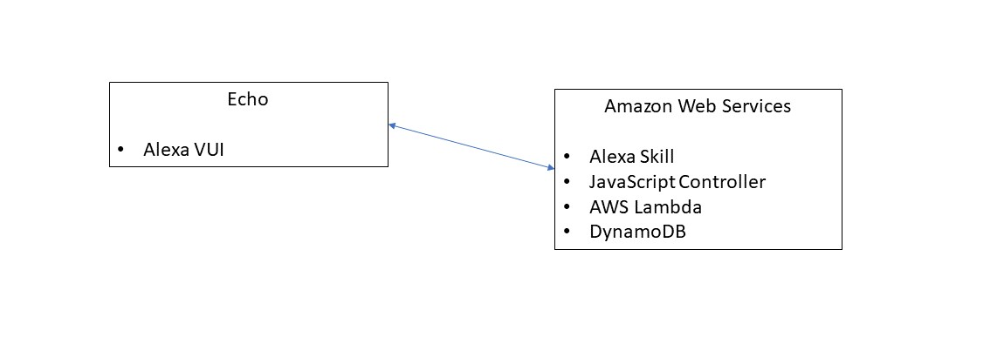
Hardware/Software Mapping

Slide 5
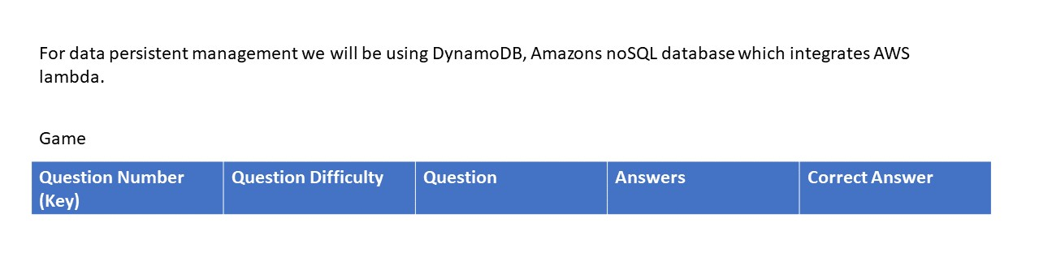
Persistent Data Management

Slide 6
Access Control and Security
User
Access through Alexa enabled device
Device is linked to users Amazon account
Authentication is handled through Amazon Security Service
Able to use all VUI features
APH Admin
Access to interaction models, hosted services, and database
Allow updates and revisions

Slide 7
Boundary Conditions
Start up – say APH trivia game
Shutdown – say Alexa quit
Errors & Exceptions
If in game- Alexa will repeat valid inputs
Out of game – Error report will be generated, game state will not be saved
Data Migration- Data will be saved through AWS in the cloud, DynamoDB will be the database used to store data

